Slide 1
PINTEREST Cloning A MernStack approach
Sri Krishna M
22EC164

Slide 2
INtroduction
In today's digital era, social media platforms like Pinterest have revolutionized the way we discover and share ideas, inspirations, and interests. These platforms provide a visual and interactive experience that connects users with content and communities around the world. Our project aims to replicate the essence of Pinterest by creating a clone using the powerful MERN stack. The MERN stack, consisting of MongoDB, Express, React, and Node.js, offers a comprehensive solution for full-stack development, enabling us to build robust and scalable web applications. By building a Pinterest clone, we not only hone our skills in full-stack web development but also gain insights into the architecture and functionalities of a popular social media platform. This project will encompass essential features such as user authentication, image upload and storage, a dynamic image feed, and user profiles with boards, providing a hands-on experience in creating a complex and interactive web application.

Slide 3
Existing SyStem
Pinterest, a renowned social media platform, has redefined how users explore, curate, and exchange ideas through captivating visuals.
With its seamless integration of images and videos, Pinterest facilitates inspiration, creativity, and collaboration among its vast user base.
This platform boasts a visually appealing layout, personalized recommendations, and collaborative boards, making it a go-to destination for individuals seeking inspiration across various interests and hobbies.
Creating a clone of Pinterest provides an opportunity to delve into its intricate architecture, user experience, and underlying technologies.
It offers a hands-on approach to dissecting the platform's features and functionalities, enabling developers to gain invaluable insights into its inner workings

Slide 4
Proposed SYSTEM
Architecture: Our proposed system leverages the MERN stack - MongoDB for database management, Express.js for server-side development, React.js for building the user interface, and Node.js for runtime environment.
Components: "The Pinterest clone will include features such as user authentication, image uploading, content discovery through feeds and search, and social interactions like liking, commenting, and sharing."
Functionality: "Users will be able to create boards, pin images/videos, follow other users, and curate personalized collections based on their interests."

Slide 5
SOFTWARE REQUirEMent
MongoDB: NoSQL database for storing user data, pins, and boards.
Express.js: Web application framework for building the backend server and API endpoints.
React.js: JavaScript library for building the frontend user interface and components.
Node.js: JavaScript runtime environment for executing server-side code.
Additional libraries/tools: npm (Node Package Manager), Axios for HTTP requests, JWT (JSON Web Tokens) for user authentication.

Slide 6
MODULES
Image Upload and Storage
Image Feed and Search

Slide 7
Module Description
Image Upload and Storage:
Users will be able to upload images to the platform.
These images will be stored in a cloud storage service like AWS S3 or another alternative, and their URLs will be saved in MongoDB.
This ensures efficient storage and retrieval of media files, enabling users to share high-quality images without performance issues.

Slide 8
Module description
Image Feed and Search:
The application will feature a dynamic image feed that displays images uploaded by all users.
This feed will be continuously updated and provide an engaging way for users to explore new content.
Additionally, we will implement a search functionality that allows users to find images based on tags or keywords, enhancing the usability and discoverability of the platform.

Slide 9
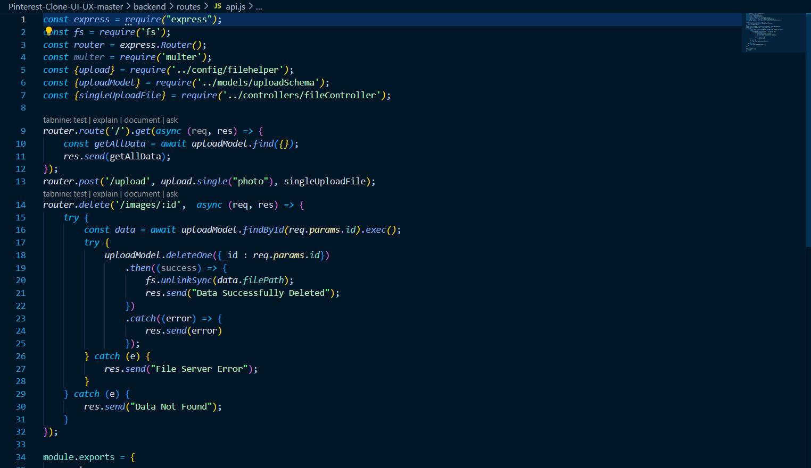
API Code

Slide 10
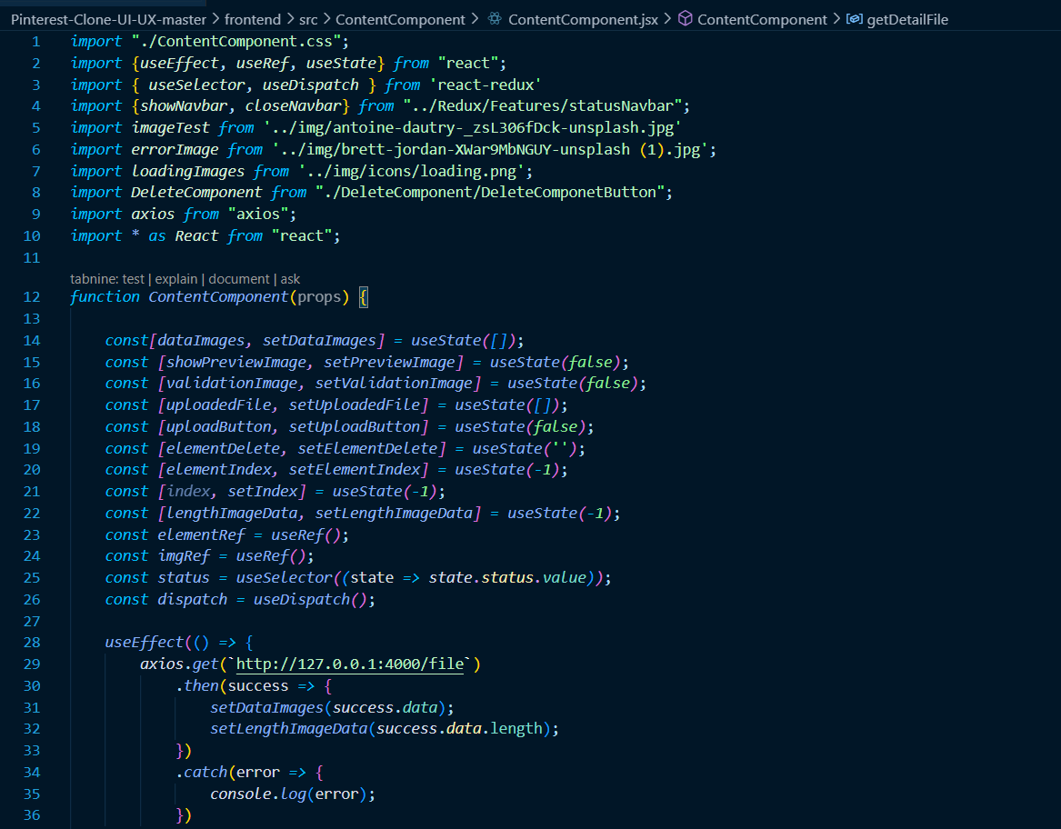
Image Feed

Slide 11
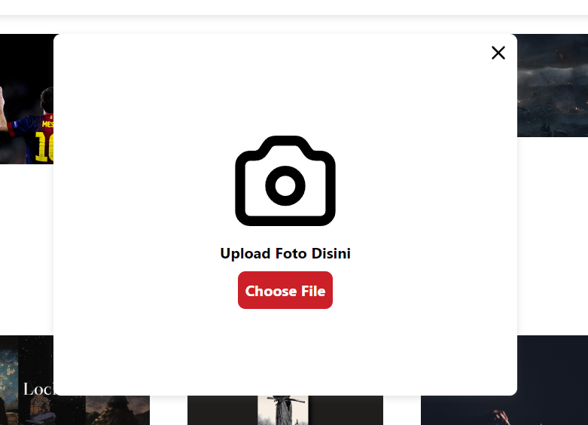
Image Feed

Slide 12
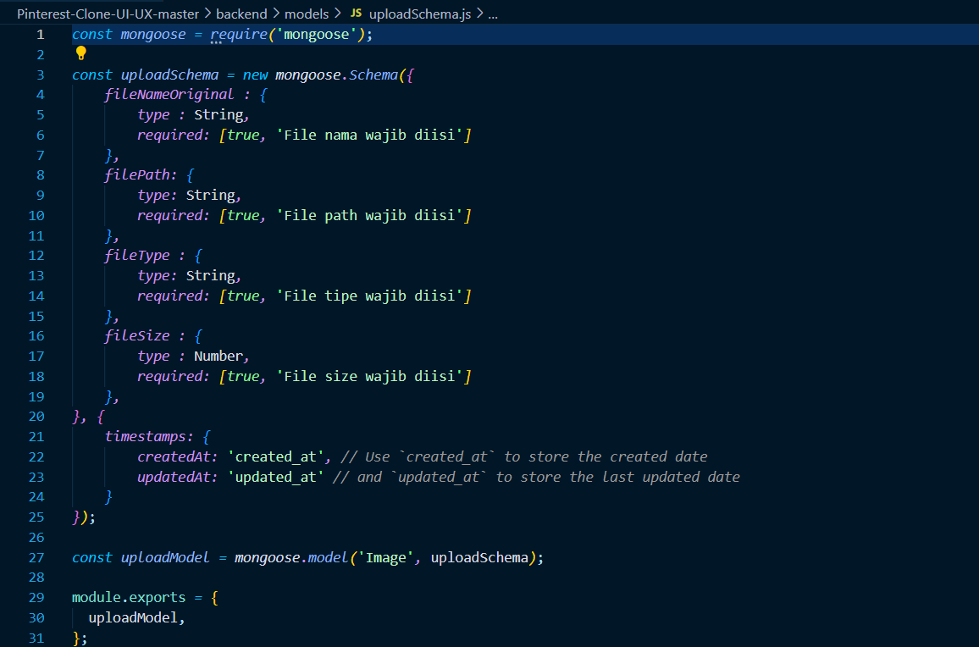
Upload Schema

Slide 13
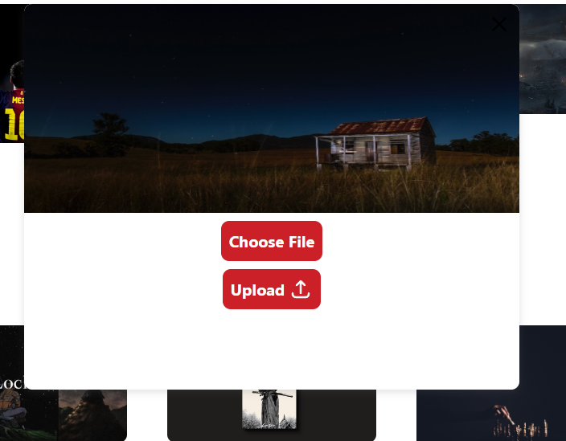
Image Feed

Slide 14
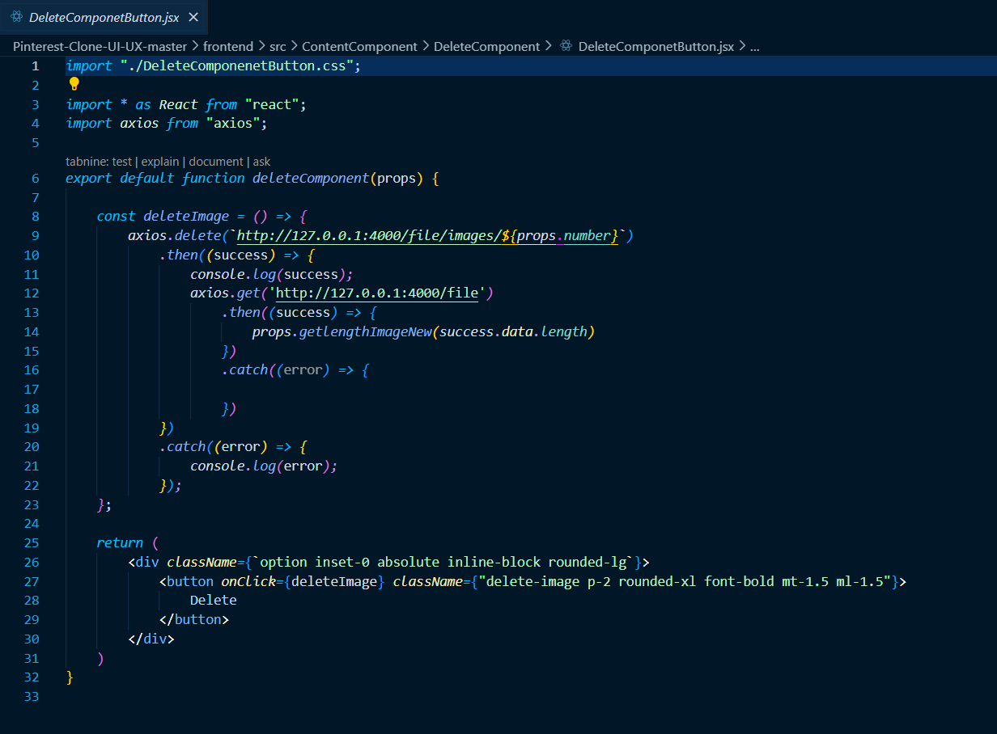
Image delete

Slide 15
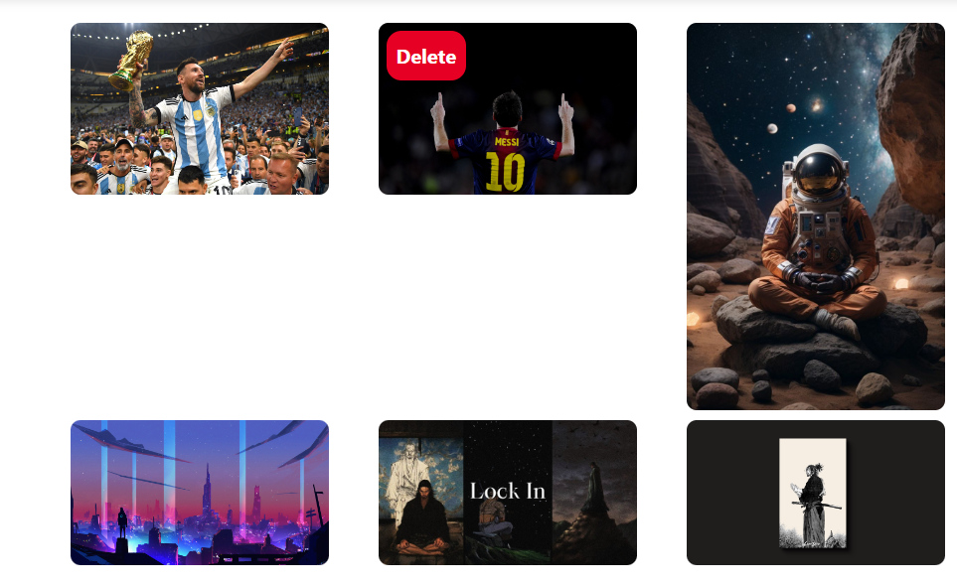
Image delete

Slide 16
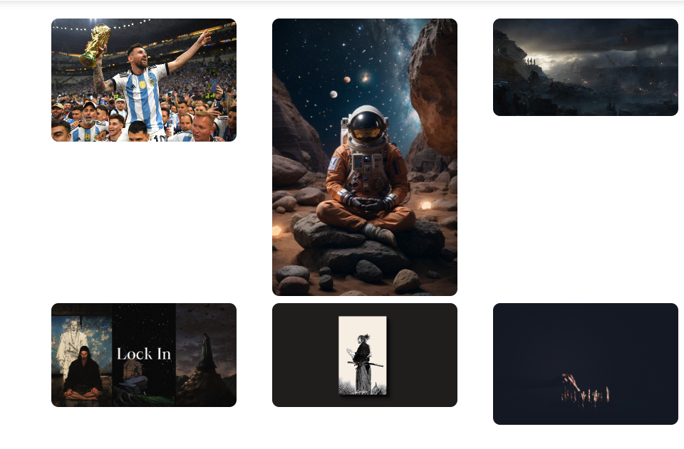
Image delete

Slide 17
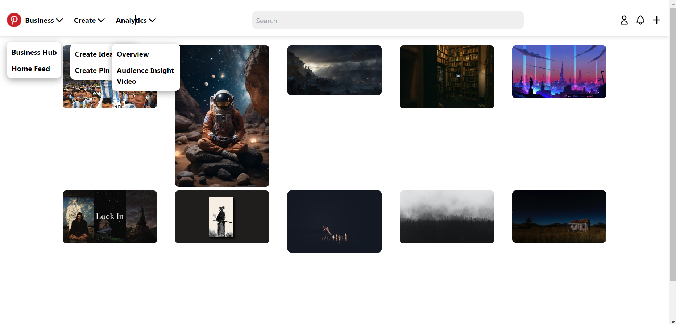
Final Output

Slide 18
FUTURE SCOPE
Enhanced Social Interactions:
Introduce features such as comments, likes, and real-time notifications to foster greater user engagement and interaction.
Advanced Search and Discovery:
Implement machine learning algorithms for personalized recommendations and advanced search capabilities, enhancing user experience and content discoverability.
Monetization and Analytics:
Integrate monetization strategies such as promoted pins and advertisements, along with detailed analytics for users and administrators to track engagement and performance metrics.

Slide 19
CONCLUSION
In building a Pinterest clone using the MERN stack, we've explored the intricate architecture and dynamic functionalities that make social media platforms engaging and user-centric.
Leveraging MongoDB, Express.js, React.js, and Node.js, we've created a robust and scalable application that mirrors Pinterest's core features while allowing for innovation and customization.
This project not only enhances our full-stack development skills but also provides valuable insights into creating compelling user experiences.
Thank you for joining us on this journey of discovery and development.

